Slide 1
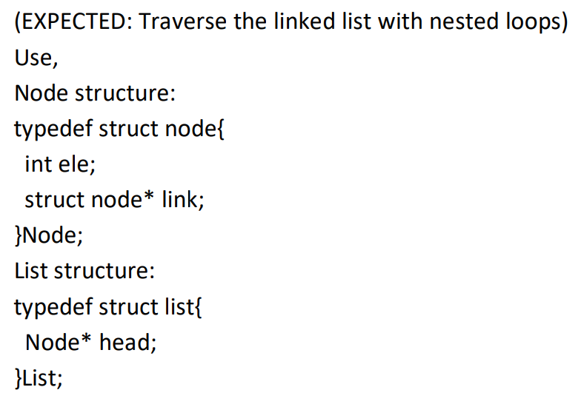
1. You are given with a linked list in which it is guaranteed that only one element occurs exactly once and all the other elements occur exactly twice. Print the element that occurs exactly once.

Slide 2
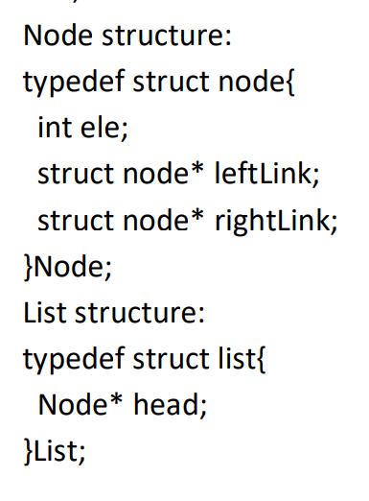
2. You are given with a sorted doubly linked list. Remove all the duplicates in the same. Constraints: No auxiliary space can be used.

Slide 3
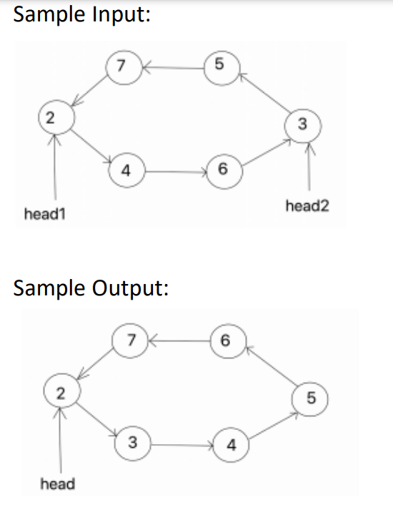
3. You are given with a circular linked list, which is the combination of two increasingly sorted linked lists joined end to end in a circular manner. You are given with two node pointers head1 and head2 pointing to first element of the individual sorted lists. Modify the existing linked list to a sorted circular linked List and return a single pointer head pointing to the first element in the list. Constraints: You cannot use any auxiliary space.

